Slide 1
Developing a School DREAM Team in the Absence of a DREAM Act
Presentation By:
Joselin Cisneros, Post-Secondary Coordinator & Undocumented Student Advisor at FCA
Quintiliano Rios Perez, Post-Secondary Coordinator & Undocumented Student Advisor at LVLHS
Notes:
Joselin

Slide 2
Icebreaker
Notes:
Quinti

Slide 3
Who we are:
Enlace Chicago:
Improving the quality of life of Little Village residents
Avanza Little Village en route to College
1 on 1 Model
Career exploration & Academic Intervention
Undocumented Student Advisor
Notes:
Joselin

Slide 4
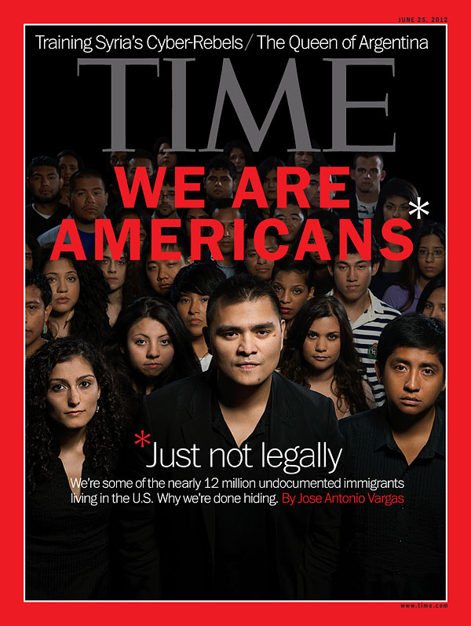
Why?
Notes:
Quinti
Financial Constraints
Unaware of Opportunities
Mental Health (Stress, Anxiety, Fear)
Limited Opportunities
Living in the Shadows

Slide 5
Legislations/Executive actions
 | Federal | State
Current | DACA | Illinois Dream ACT ACEVEDO BIll
Pending | Extended DACA DAPA (Supreme Court) Dream Act Comprehensive Immigration Reform | Student Access Bill
Notes:
Joselin

Slide 6
Scenarios
Notes:
Quinti
Pass Out Sheet!

Slide 7
 | What went well? | What can be improved?
Act 1
Act 2
Act 3

Slide 8
What went well?
Notes:
Quinti

Slide 9
What can be improved?
Notes:
Joselin

Slide 10
What can be done to motivate students?
Personally | institutionally
Stay updated about resources and policies Provide students with correct info/ refer to reliable resources Engage in advocacy efforts: Elections, Lobbying for the ACCESS Bill, raising awareness. | Create a safe space/make it visual Revise school policies to be inclusive of undocumented students School leadership releases a statement of support for undocumented students. Institution has a point-person/liaison in regards to undocumented students. Training staff about working with undocumented students (sensitivity) Support/Sponsor an undocumented student organization
Notes:
Quinti

Slide 11
Supporting students to a path for Career & Success
Readily available scholarships & Resources
List of institutions who provide financial aid to undocumented students
Internships
Mental health check-ins
Other careers
Mentorship
Notes:
Joselin

Slide 12
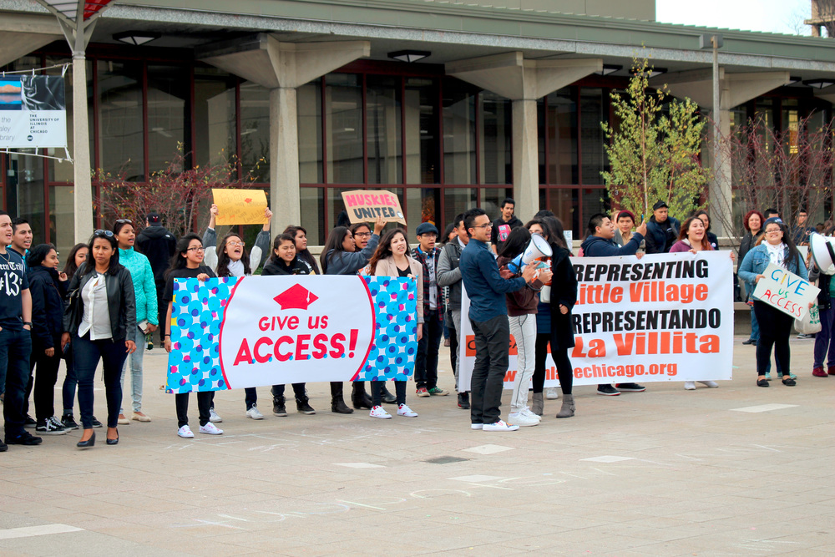
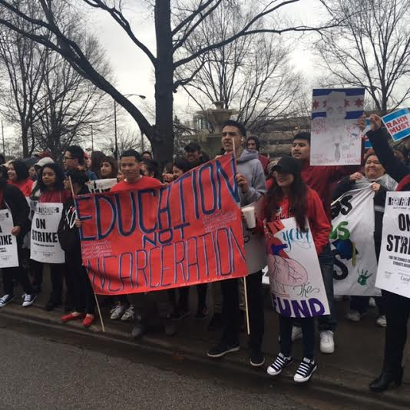
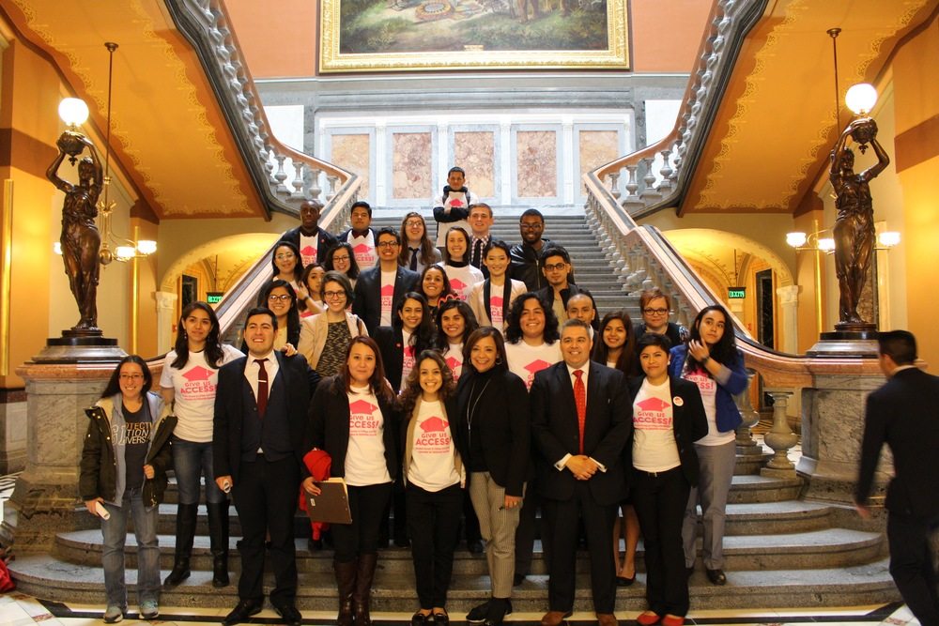
Advocacy
Notes:
Joselin
Springfield
Voting
Student Access Bill

Slide 13
Q & A
Notes:
Quinti
What are some challenges you are facing at your school?
What are you doing at
your school/campus?

Slide 14
Questions?
Joselin Cisneros, Post-Secondary Coordinator & Undocumented Student Adviser
Enlace Chicago
(773) 679-7990 cell
jcisneros@enlacechicago.org
Quintiliano Ríos Pérez
Avanza Postsecondary Coordinator & Undocumented Student Advisor
Enlace Chicago-
773-535-4237 | 312- 324-4602 mobile
qrios@enlacechicago.org
Special Thanks to Luis Narvaez
Director of Strategic Projects, Chicago Public Schools
jcisneros@enlacechicago.org
Notes:
Quinti

